Slide 1
From POM to Binary: An Evidence-Based Assessment of GraalVM Native Image Readiness Using Maven Dependency Metadata
Sérgio Oliveira
x23170981@student.ncirl.ie
National College of Ireland | MSc Cloud Computer | Aug 2026
Supervisor: Punit Gupta

Slide 2

Who I Am
Sérgio Oliveira
BEng Manufacturing | MSc Cloud Computing
Manufacturing Engineer transitioning into Software Engineering and Cloud Computing.
Passionate about continuous learning and driven to design scalable cloud solutions as a future Solutions Architect.
https://www.linkedin.com/in/sergio-oliveira-063613163/

Slide 3
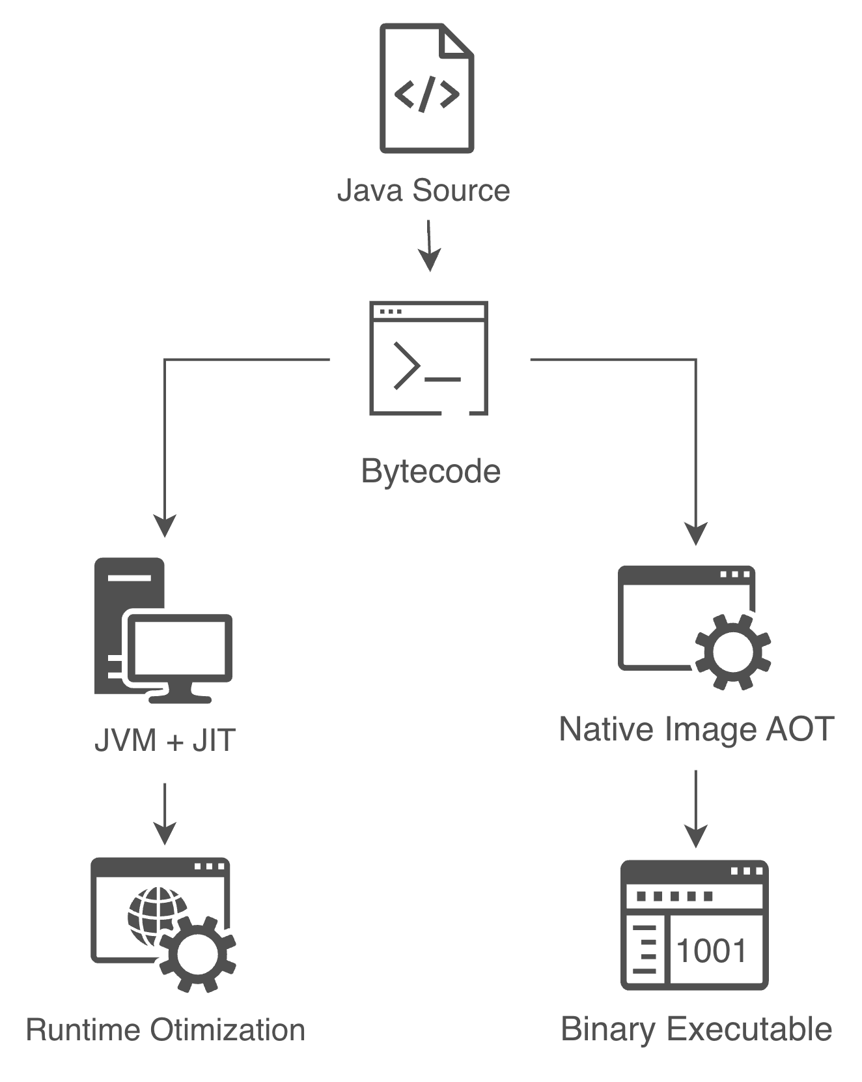
From Java Runtime to Native Executables
The JVM uses Just-In-Time compilation:
bytecode is executed by the JVM
runtime optimization occurs during execution
dynamic features are naturally supported
Native Image follows a different model:
- ahead-of-time compilation
- closed-world assumption
- static analysis before execution
https://medium.com/@ayoubtaouam/understanding-how-java-code-runs-interpreter-jit-and-aot-explained-414eafd09159

Slide 4




Why Native Image?
Native Image enables:
Faster
Lower
Smaller
Cloud
startup time
memory footprint
deployment artifacts
optimization
Native Image introduces a different deployment model optimized for specific scenarios.
https://www.graalvm.org/why-graalvm/

Slide 5
The Engineering Problem
Native Image Adoption Creates a New Migration Challenge
The challenge is not generating a binary.
The challenge is understanding whether an existing dependency ecosystem is prepared before compilation.
Large Maven ecosystem
Spring Boot
Database
Logging
Security
JSON
Third-party libraries
Can this ecosystem support Native Image?
https://www.graalvm.org/22.0/reference-manual/native-image/

Slide 6
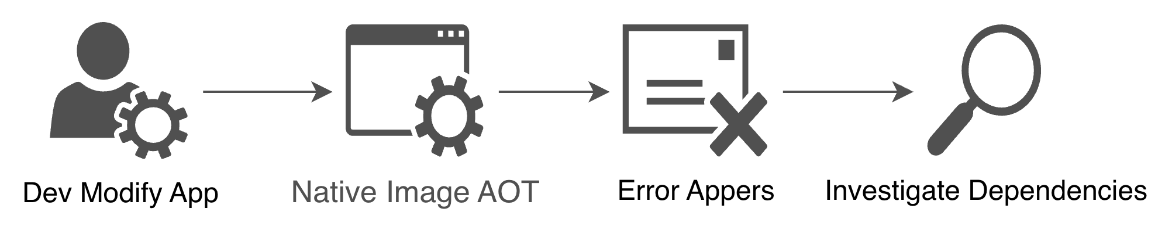
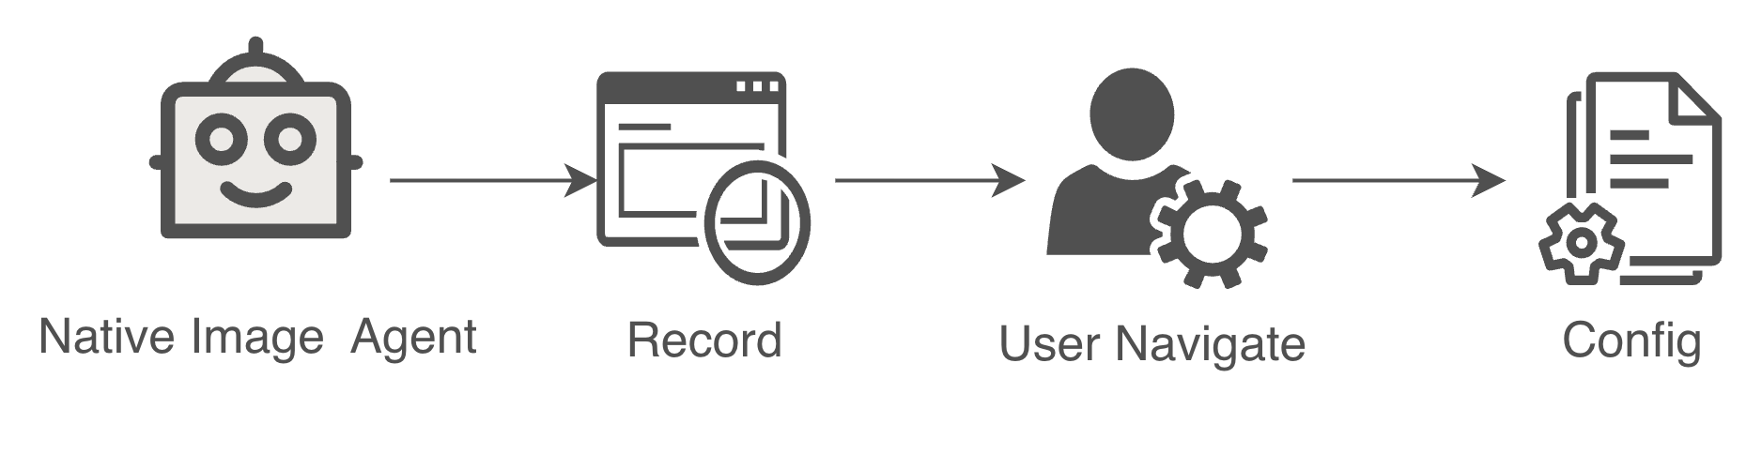
Current Practices
Compile Directly
Problems:
Expensive compilation cycles
Late discovery of incompatibilities
Difficult diagnosis
Native Image Tracing Agent
Limitations:
Runtime execution required
Depends on execution coverage
Configuration generated after implementation
https://www.graalvm.org/latest/reference-manual/native-image/metadata/AutomaticMetadataCollection/

Slide 7
Contribution based Shift-Left Opportunity
Can Dependency Analysis Provide Earlier Signals?
Software Composition Analysis already provides visibility into dependency ecosystems.
This work introduces a new perspective:
Native Image readiness can be investigated through structural evidence available in dependency metadata.
Available Native Image metadata evidence
Missing evidence signals

Slide 8
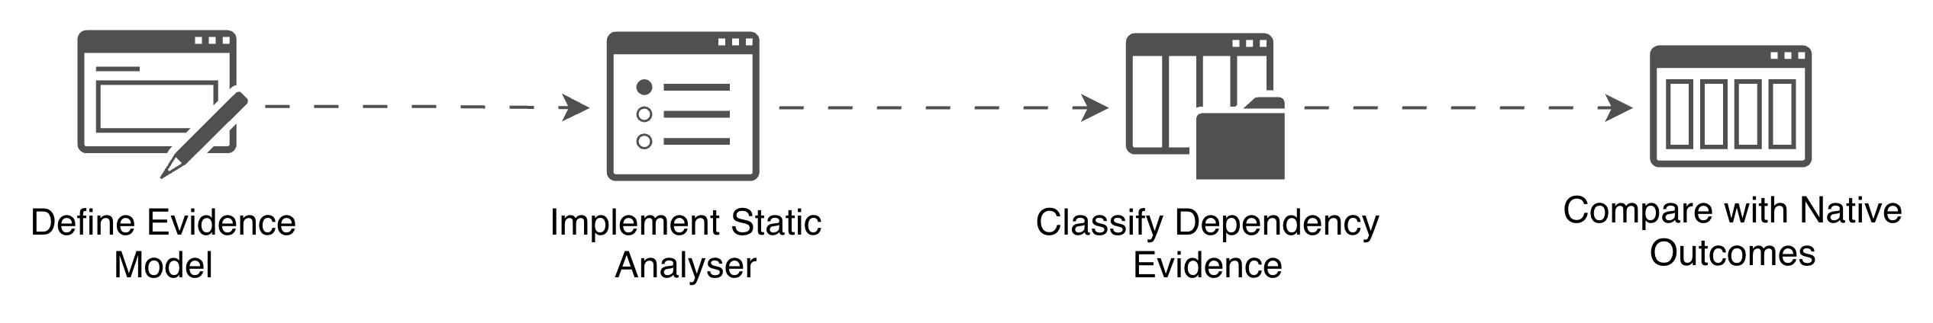
Research Question
To what extent can structural metadata signals
in Maven dependency graphs provide early evidence
of GraalVM Native Image readiness?

Slide 9
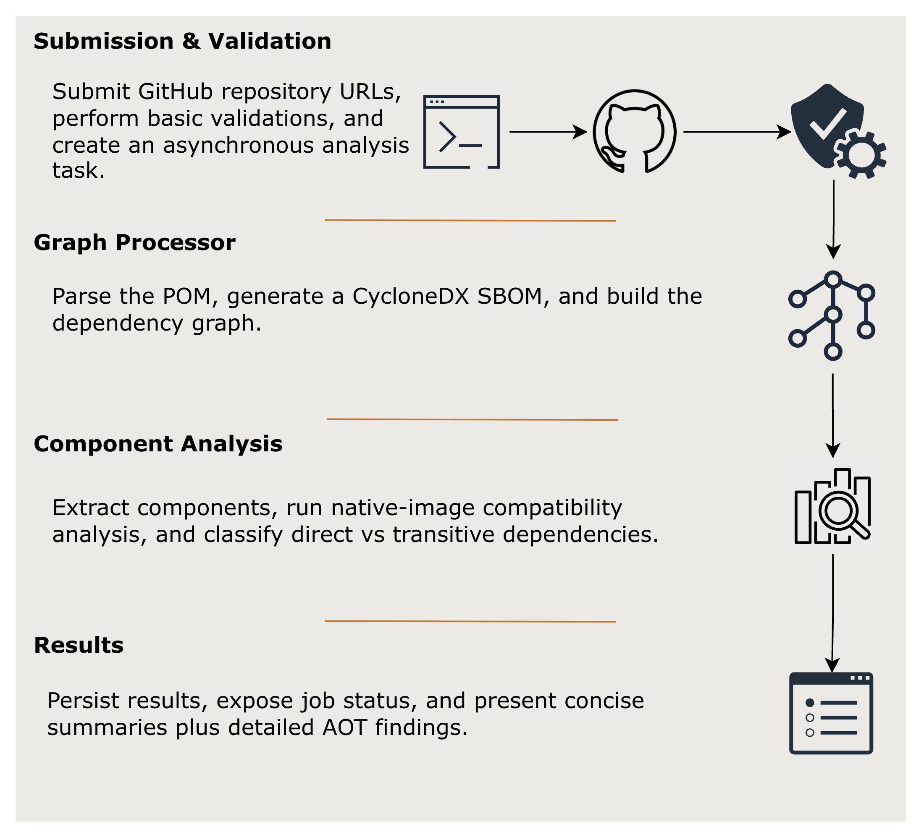
Framework
To investigate this research question, an evidence-based analysis framework was developed.
https://qba1p331pc.execute-api.eu-west-1.amazonaws.com/production

Slide 10
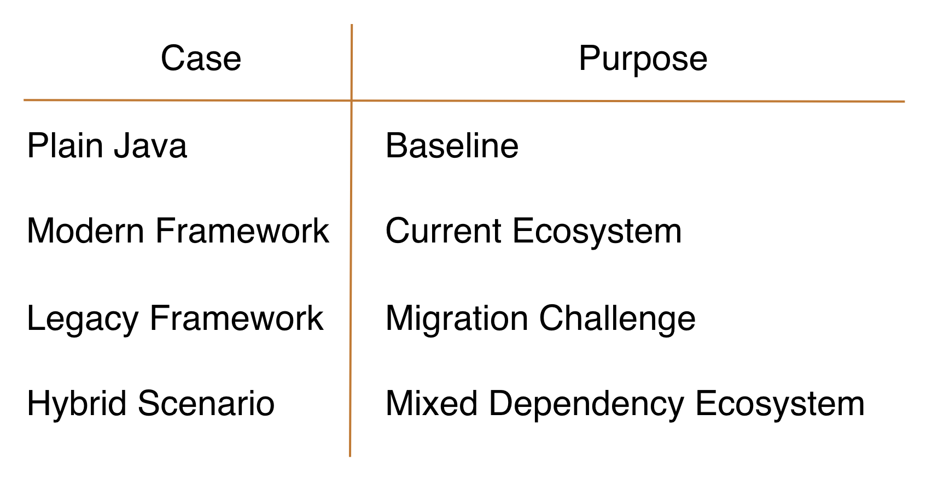
Case Studies
The framework was evaluated through four controlled case studies representing different dependency ecosystem scenarios.

Slide 11
Results
Framework successfully identified:
Supported components
Missing evidence
Indirect evidence
The framework does not replace Native Image compilation.
It provides earlier structural visibility.
Limitations
Does not analyze application reachability
Does not reproduce GraalVM analysis
Evidence availability depends on ecosystem metadata

Slide 12
Conclusion
Contribution to Knowledge:
Native Image readiness can be investigated through structural dependency evidence.
Software Composition Analysis concepts can support Native Image adoption beyond their traditional security-focused role.
Evidence-based readiness assessment provides an earlier perspective that complements native compilation rather than predicting it.

Slide 13
Additional References
Evaldsson, T. and M. Y. Bardakani (2024). ‘GraalVM’s Ahead-of-Time Compilation: Benefits and Challenges in Production’. Bachelor’s thesis. Karlskrona, Sweden: Department of Software Engineering, Blekinge Institute of Technology. DiVA id: diva2:1875531. In cooperation with Ericsson.
Harrand, N. et al. (2022). ‘API beauty is in the eye of the clients: 2.2 million Maven dependencies reveal the spectrum of client-API usages’. In: Journal of Systems and Software 184. doi: 10.1016/j.jss.2021.111134. SJR: 0.950; Quartile: Q1; H-index: 141.
Massacci, F. and I. Pashchenko (2021). ‘Technical leverage: Dependencies are a mixed blessing’. In: IEEE Security & Privacy 19(3), pp. 58–62. doi: 10.1109/MSEC.2021.3065627. SJR: 0.643; Quartile: Q1;H-index: 95.
Nicho, M., I. Effiong and C. D. McDermott (2025). ‘Shift-left security: Integrating security in the initial phase of the DevOps methodology’. In: Proceedings of the 2025 9th International Conference on Cryptography, Security and Privacy (CSP). Okinawa, Japan: IEEE, pp. 182–191. doi: 10.1109/CSP66295.2025.00037. Google Scholar citations: 1.
Pichler, C. et al. (2025). ‘Fast and compact: Reducing size of AOT-compiled Java code without sacrificing performance’. In: ACM SIGPLAN International Conference on Managed Programming Languages and Runtimes (MPLR). Singapore, 12-18 October 2025, pp. 12–22. doi: 10.1145/3759426.3760976. Google Scholar citations: 1.

Slide 14
The
End
Sérgio Oliveira
BEng Manufacturing | MSc Cloud Computing

